Slide 1
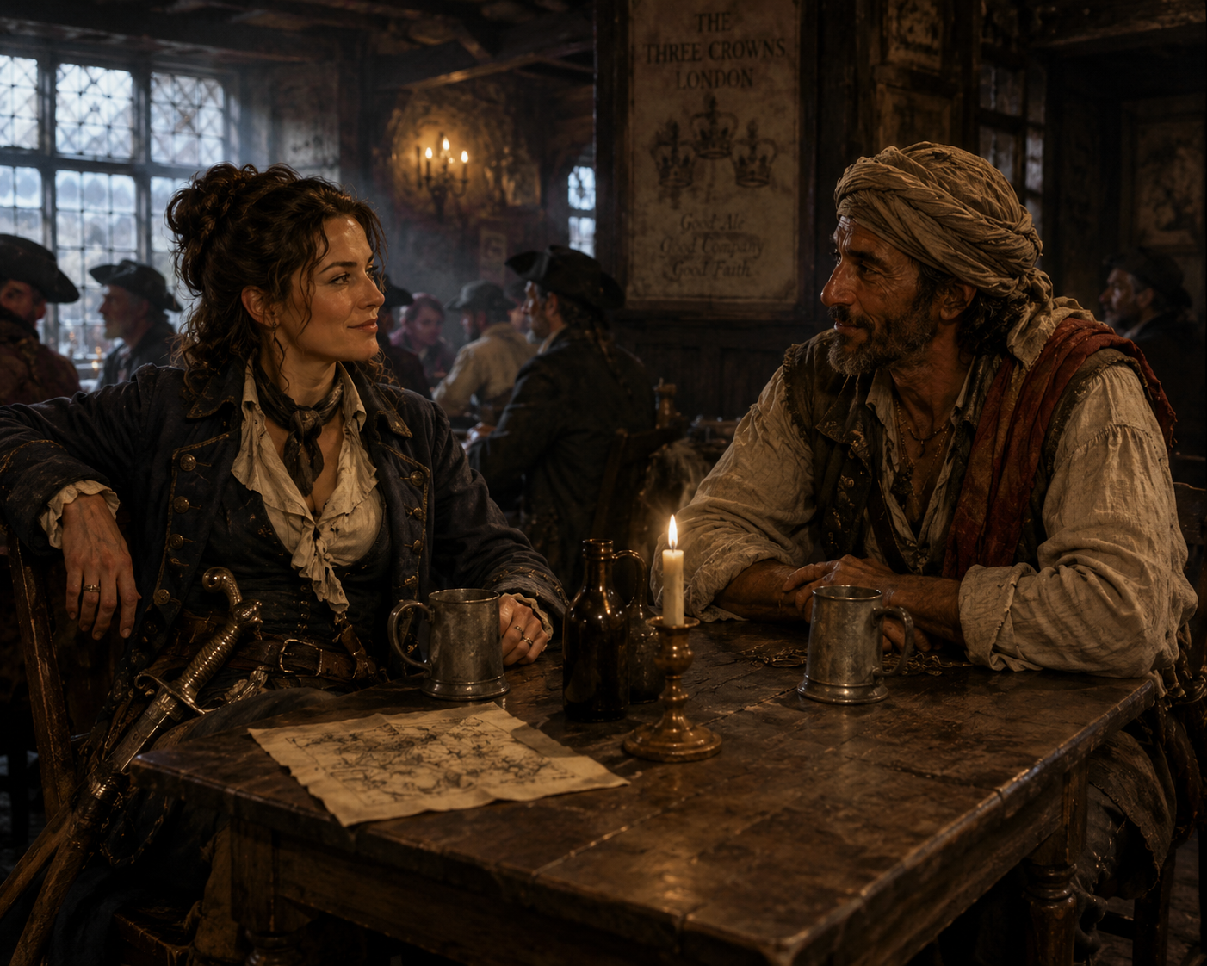

Level 1: Hisham Returns to London
Intro My Tools My Coins

Slide 2
Level 2: The Hunt for the Map
Intro My Tools My Coins

